Slide 1
QUADRATURE DOWN OSCILLATOR (FINAL-report)
A project by
SAUMYA BALINA (2022102069) and HIMANI SHARMA(2022102032)

Slide 2

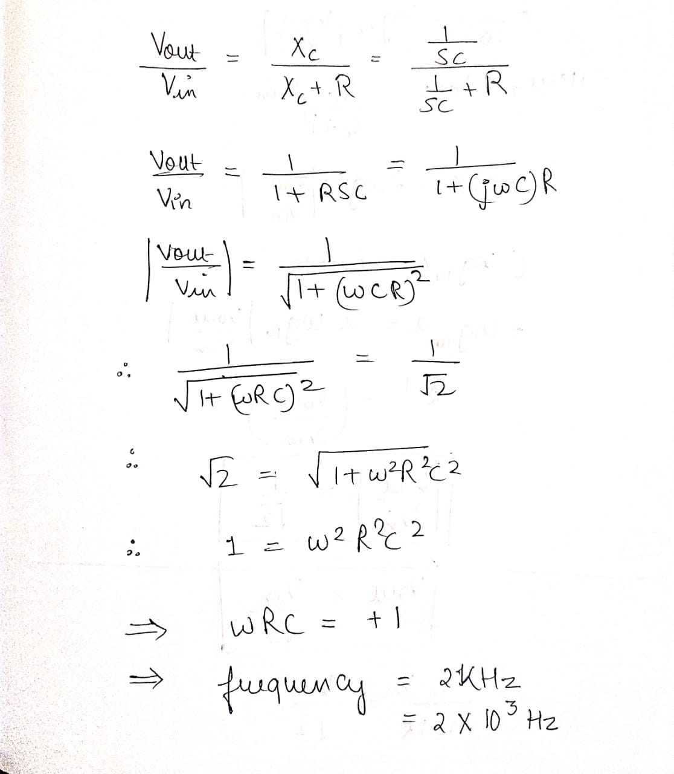
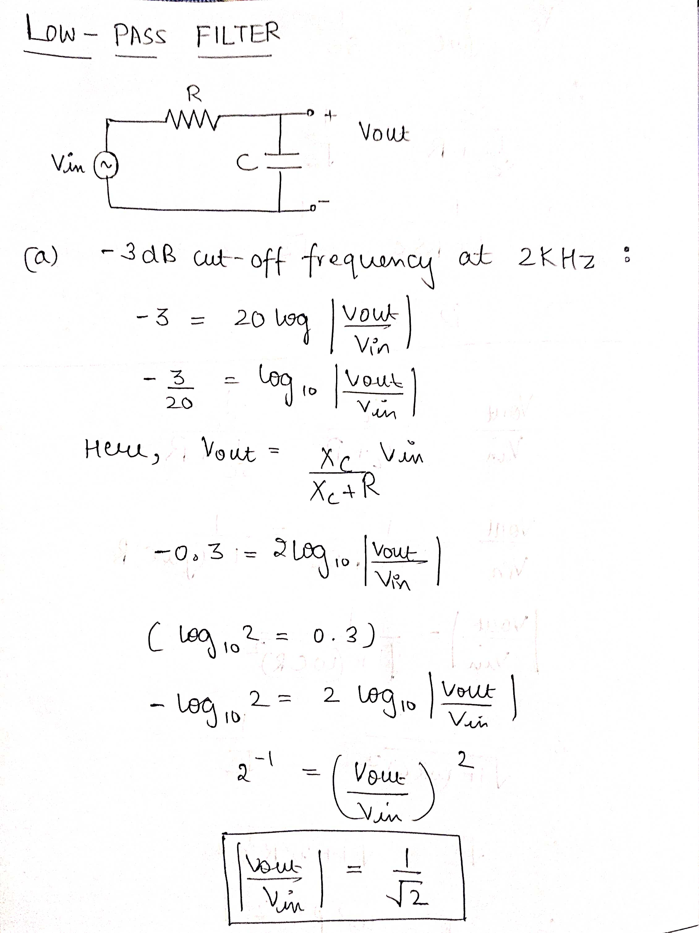
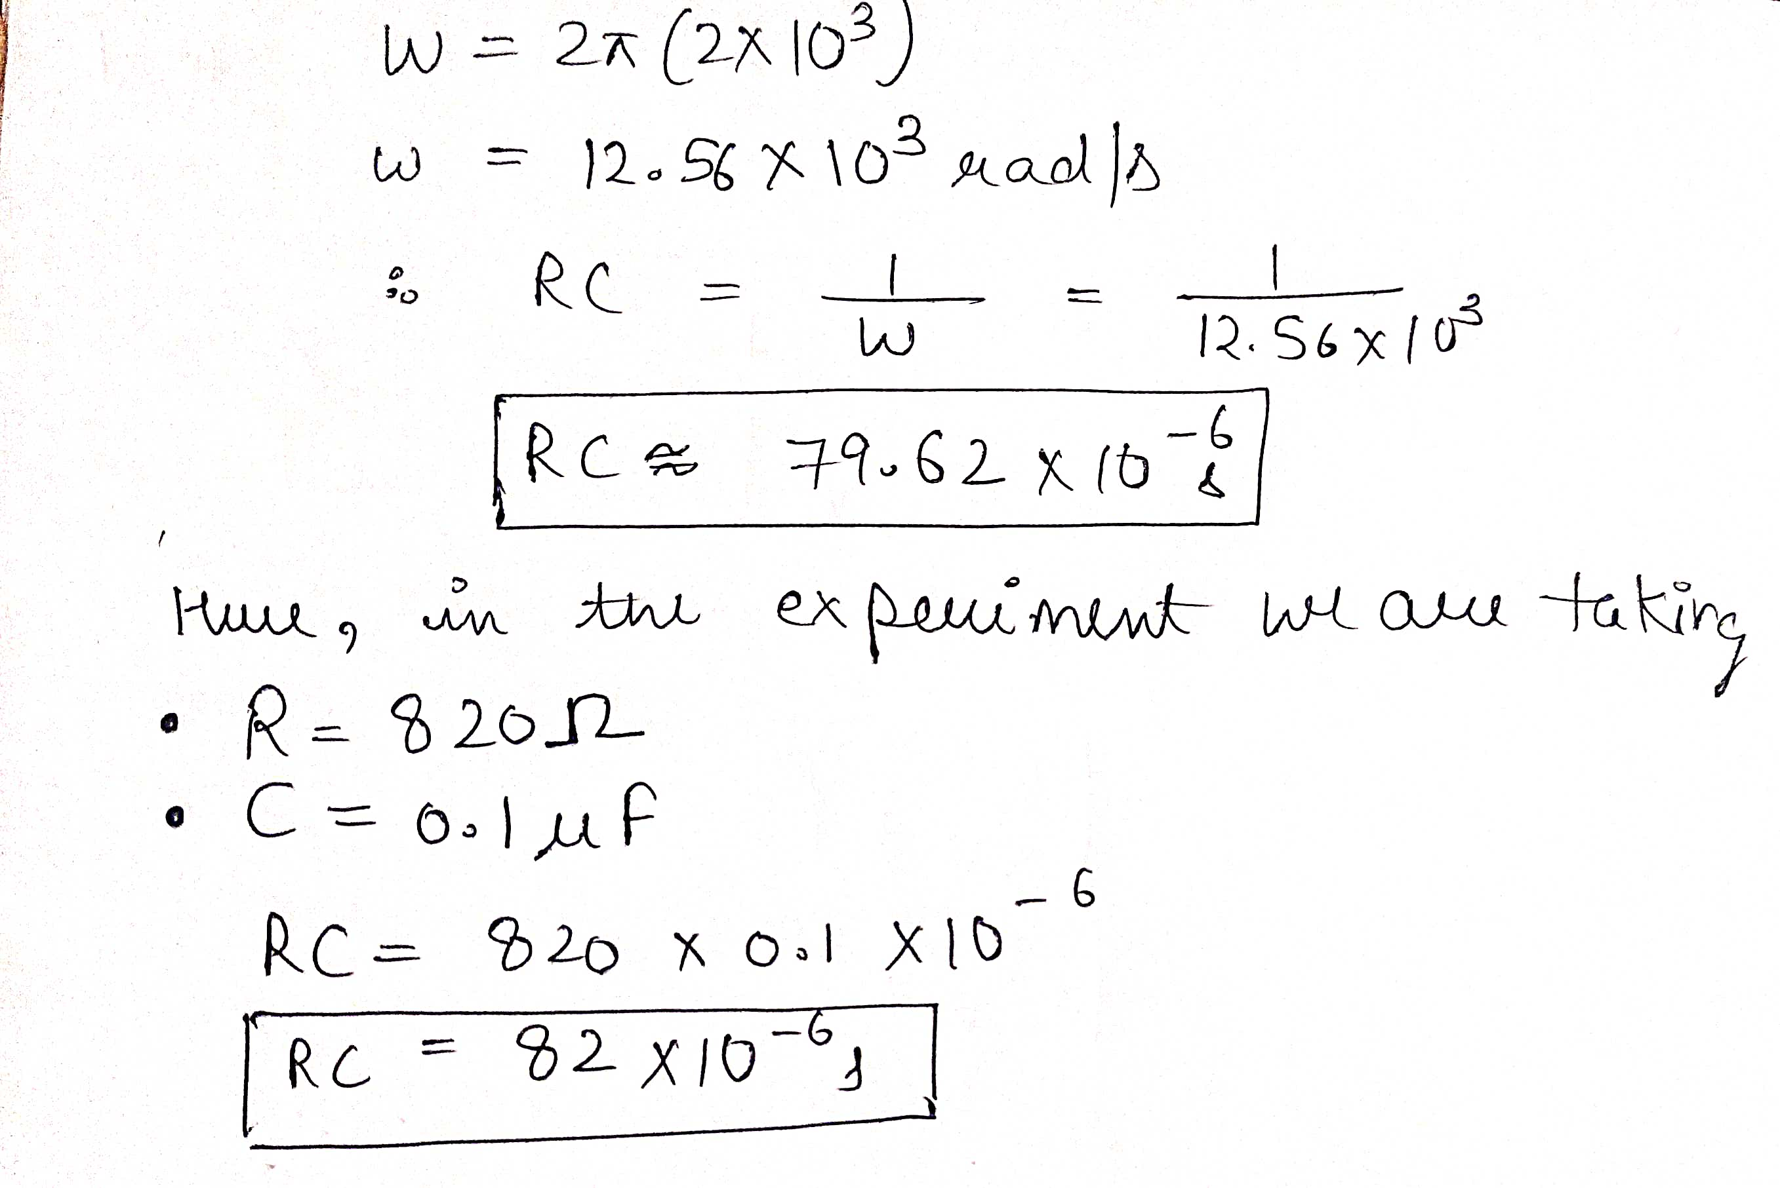

LOW PASS FILTER components taken: R = 820 Ω C = 0.1 $μ$F

Slide 3
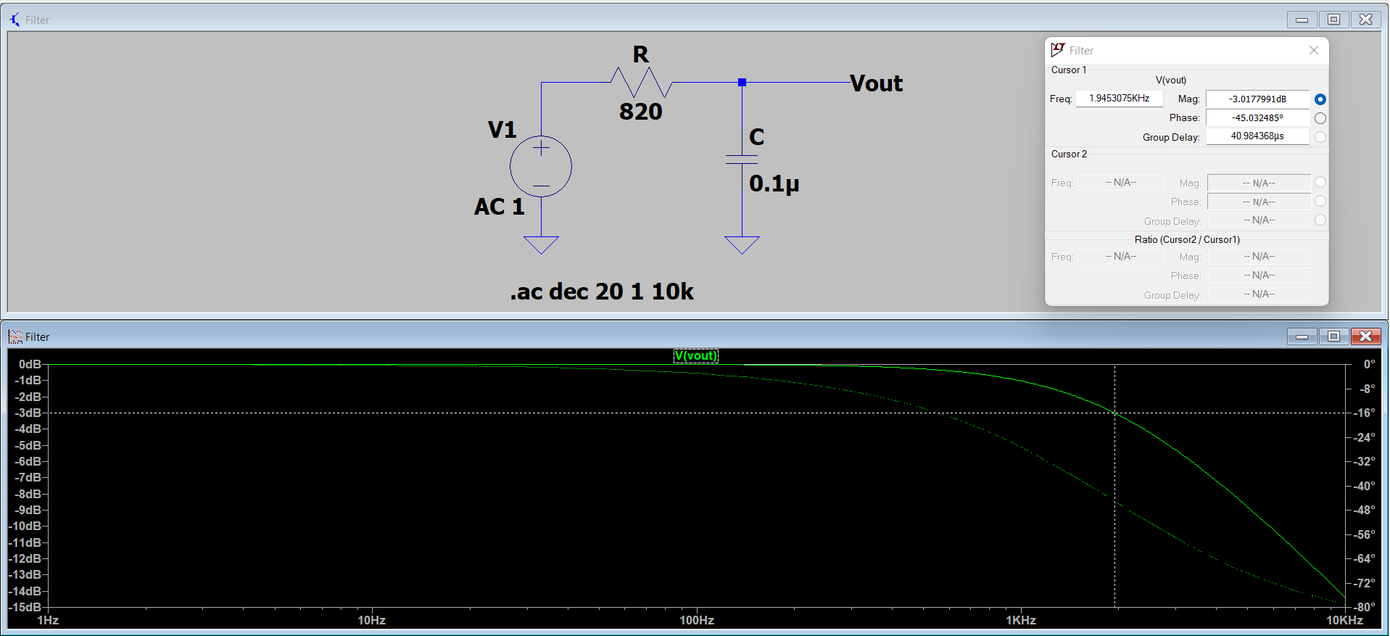
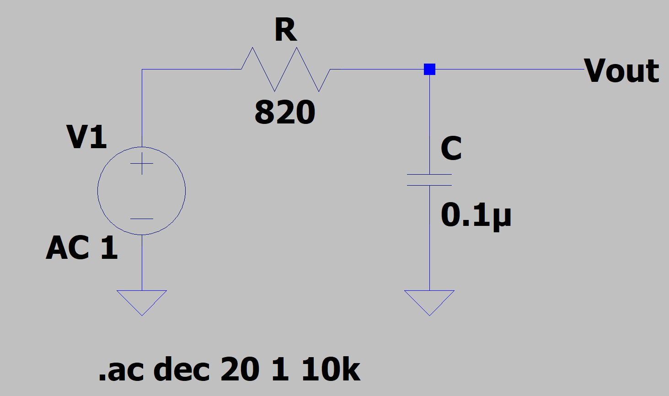
AC ANALYSIS

Slide 4

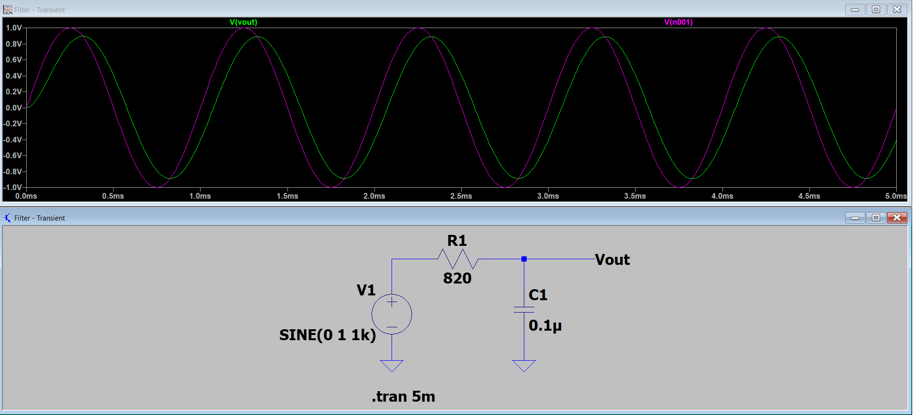
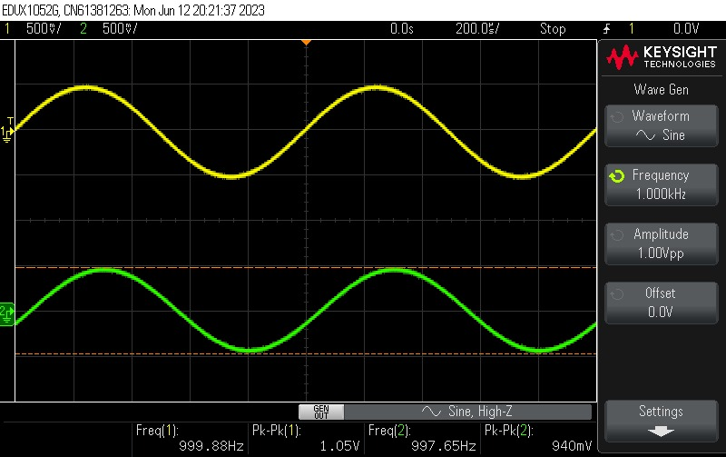
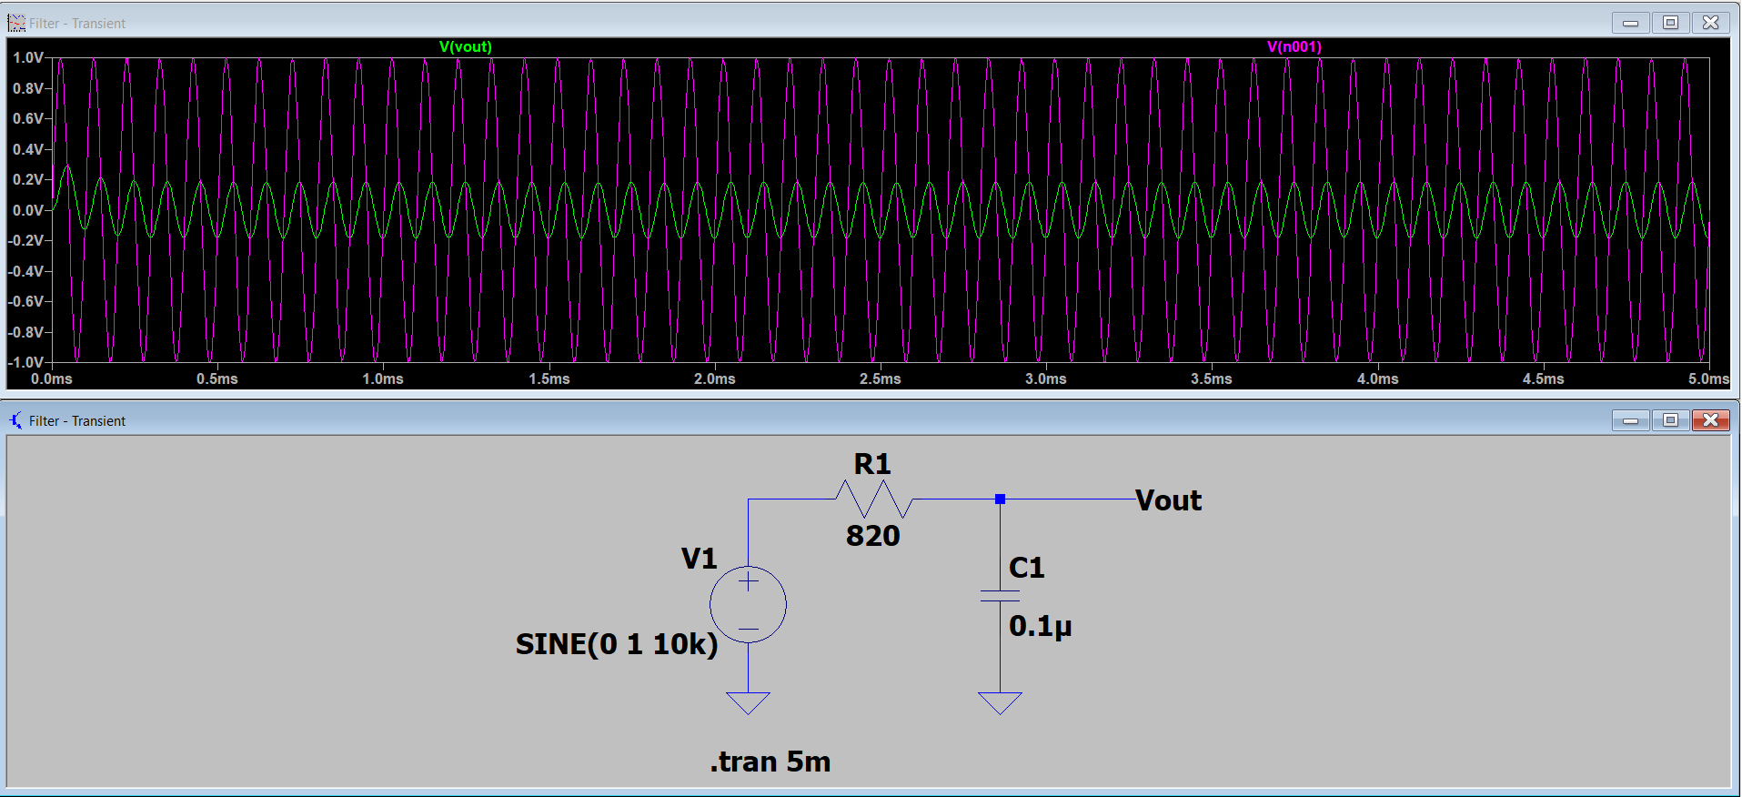
TRANSIENT ANALYSIS

Slide 5
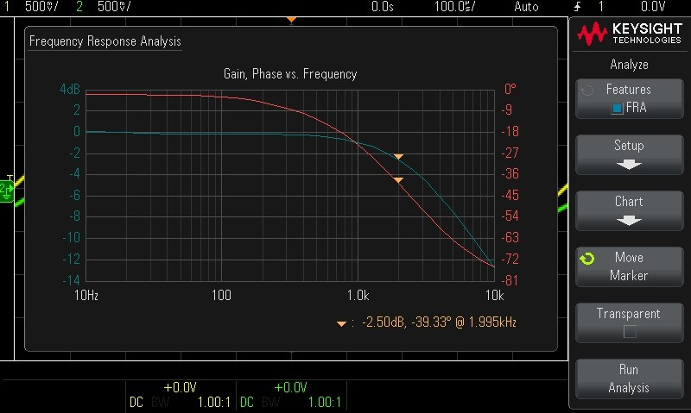
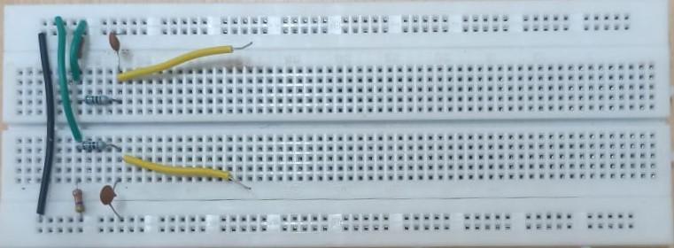
CIRCUIT IN LAB

Slide 6
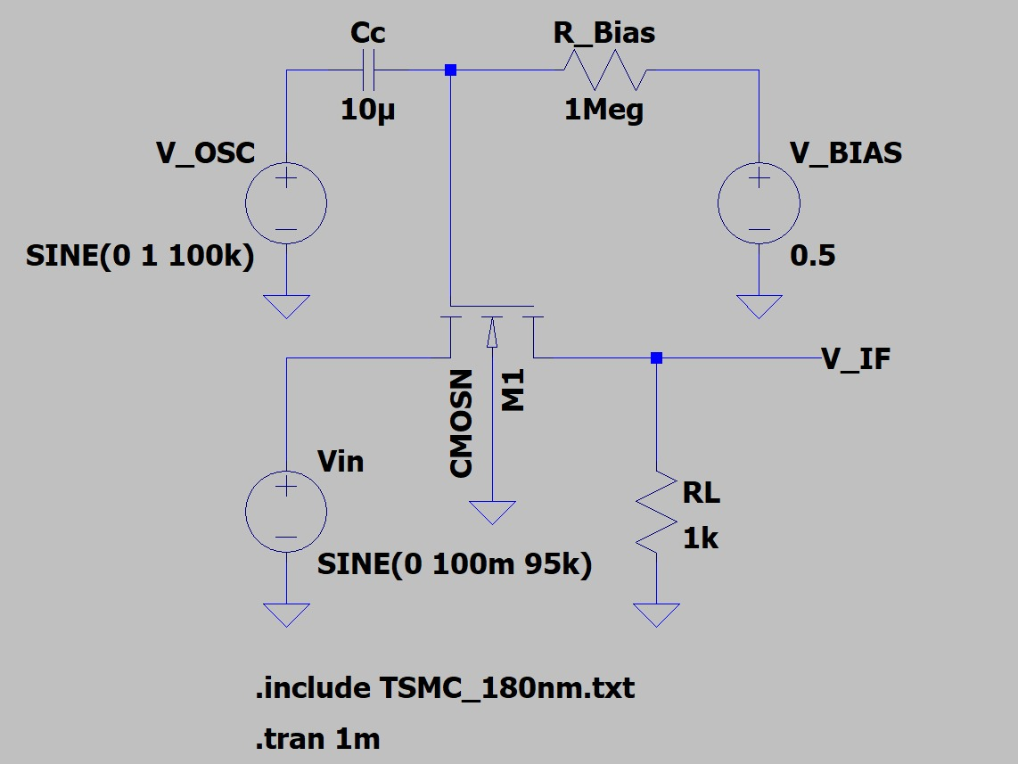
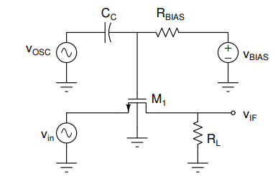
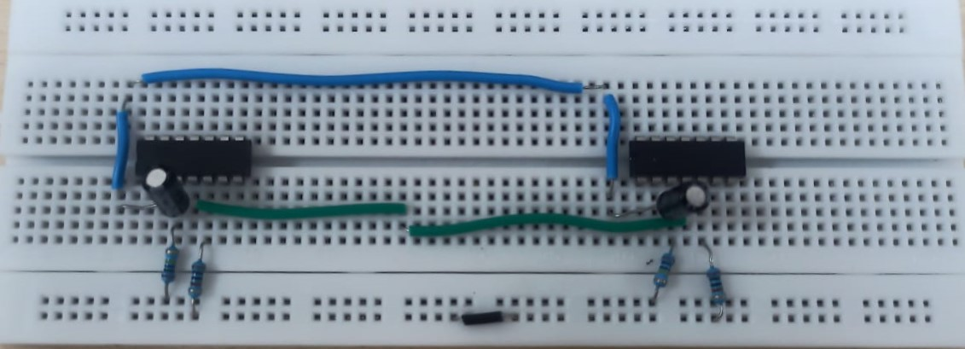

SWITCH (MIXER)
COMPONENTS TAKEN:
R_bias = 1Megaohm
Cc = 10$μ$F
RL = 1 kohm

Slide 7
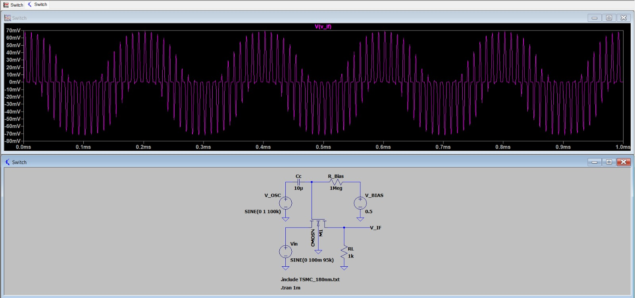
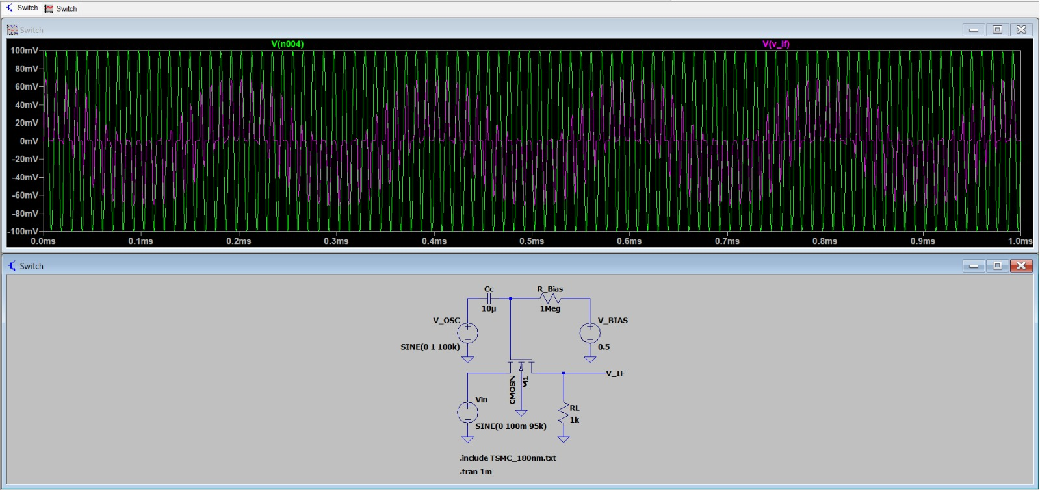
95 kHz
On LTSpice

Slide 8
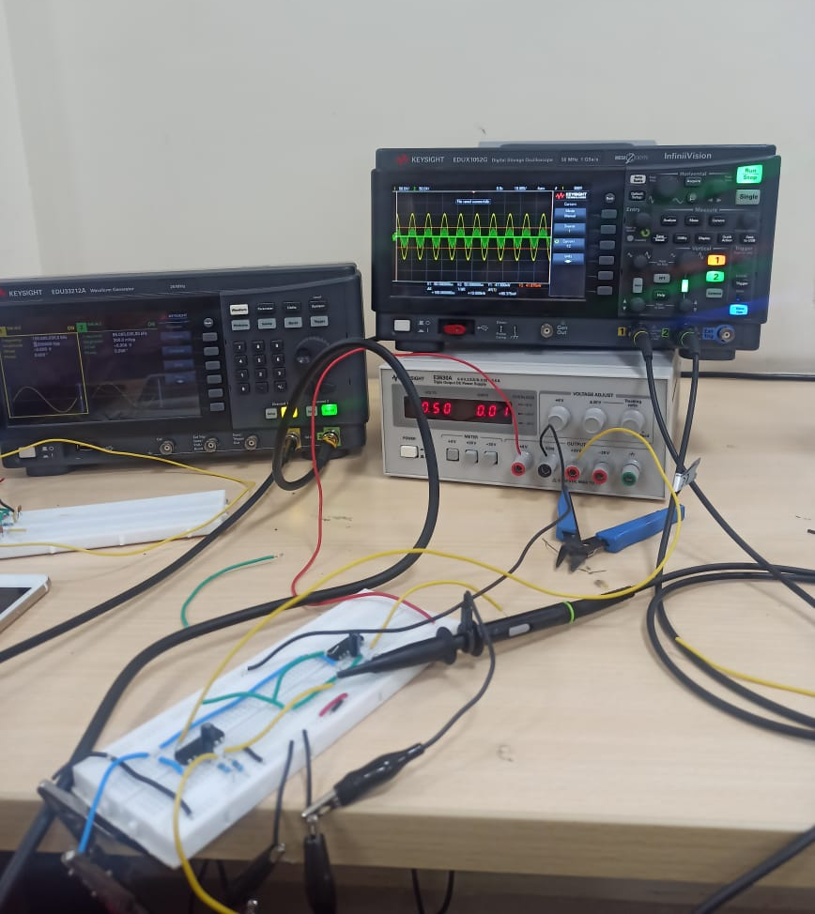
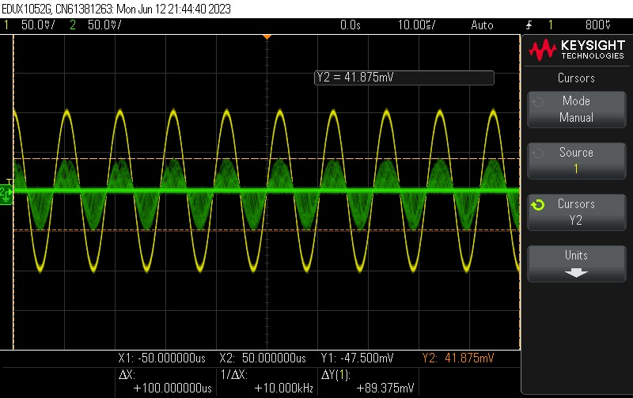
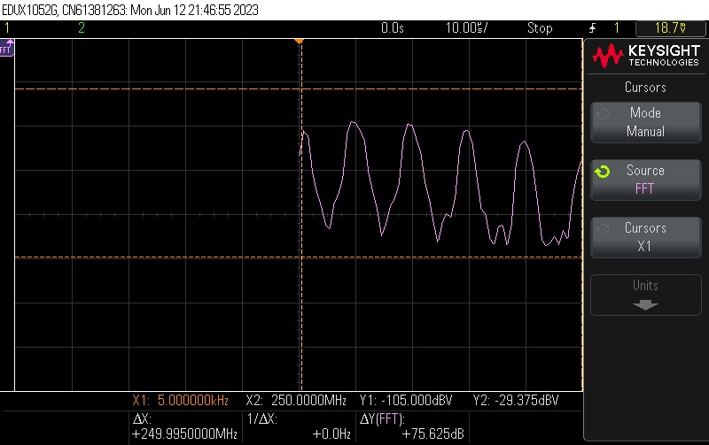
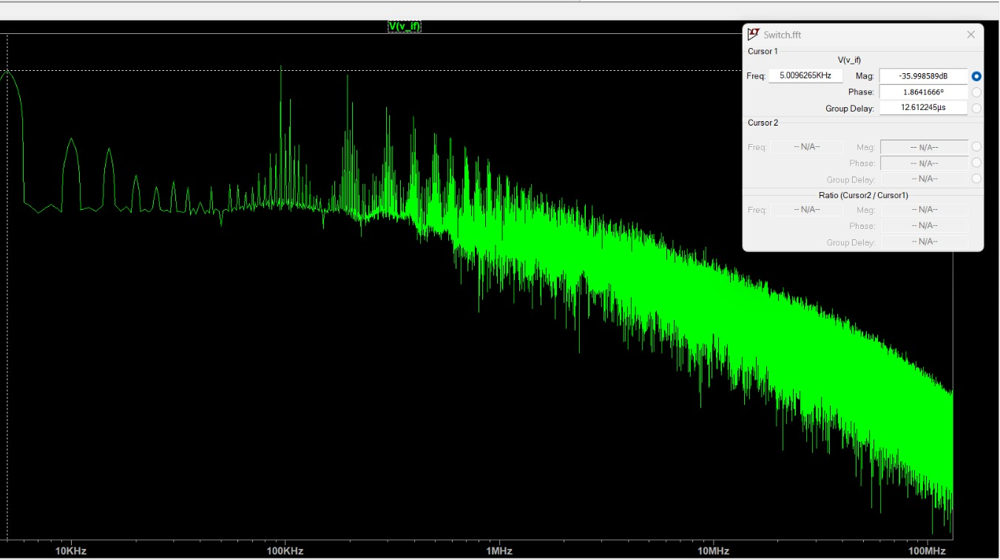
95k
Lab Experiment

Slide 9
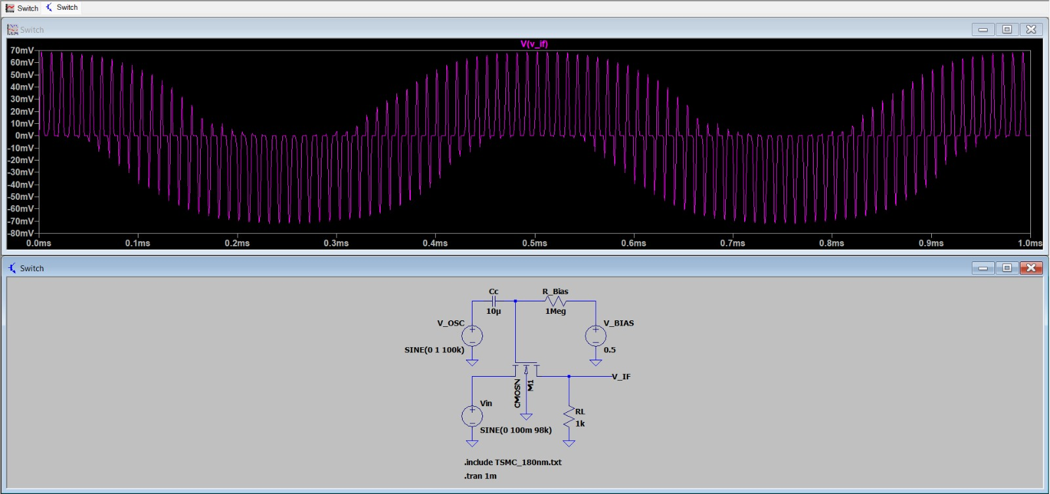
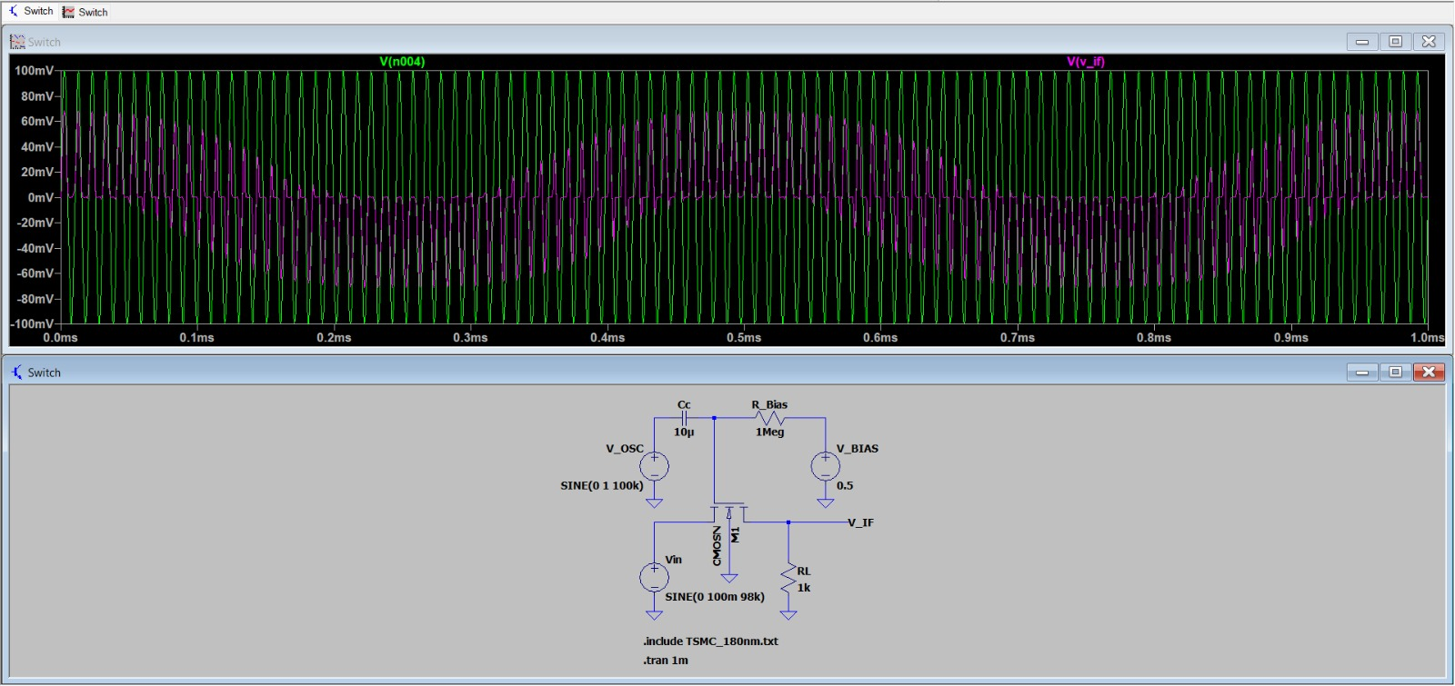
98 kHz
On LTSpice

Slide 10
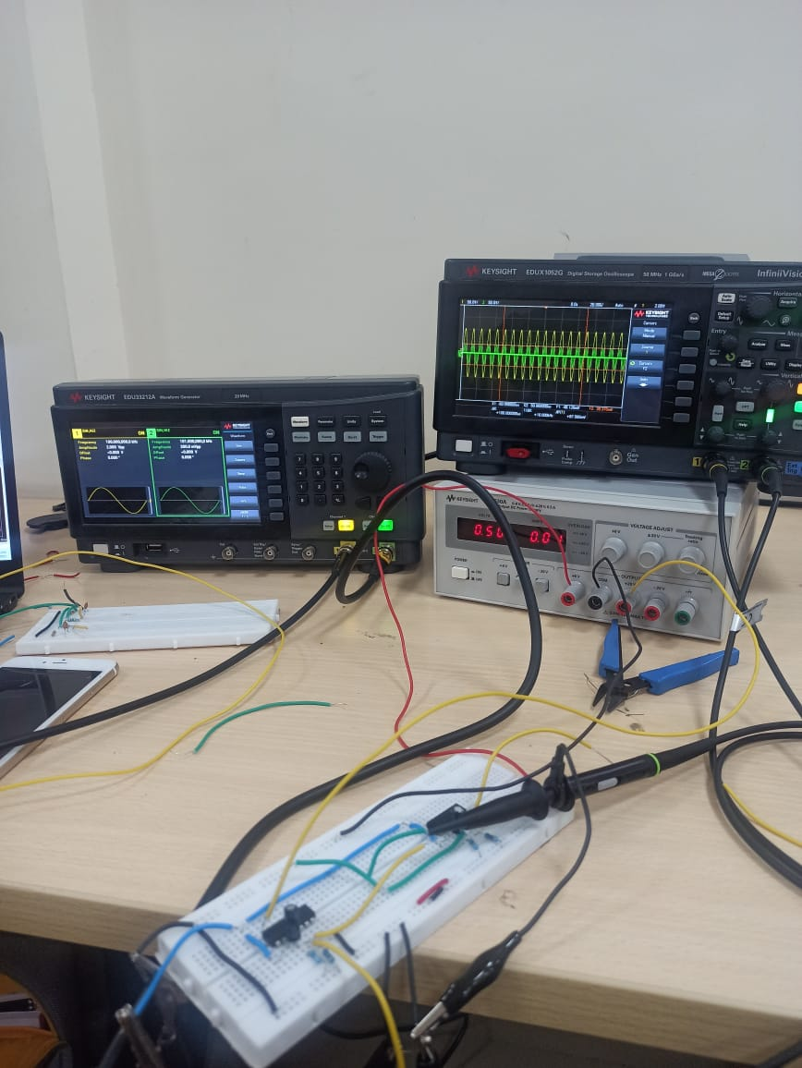
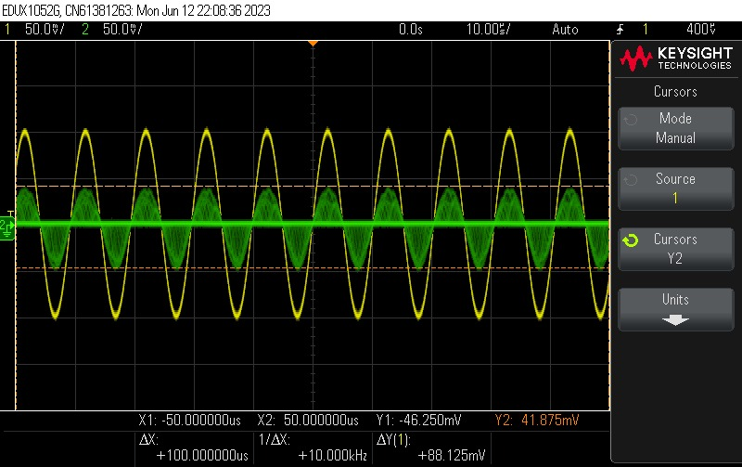
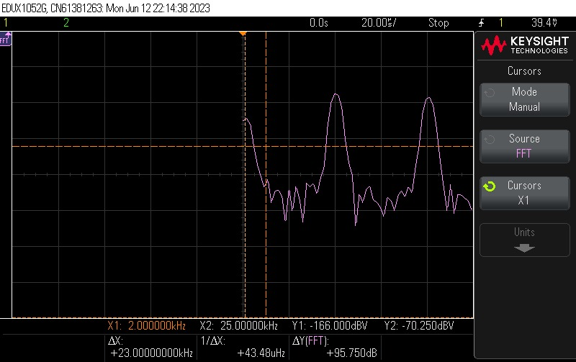
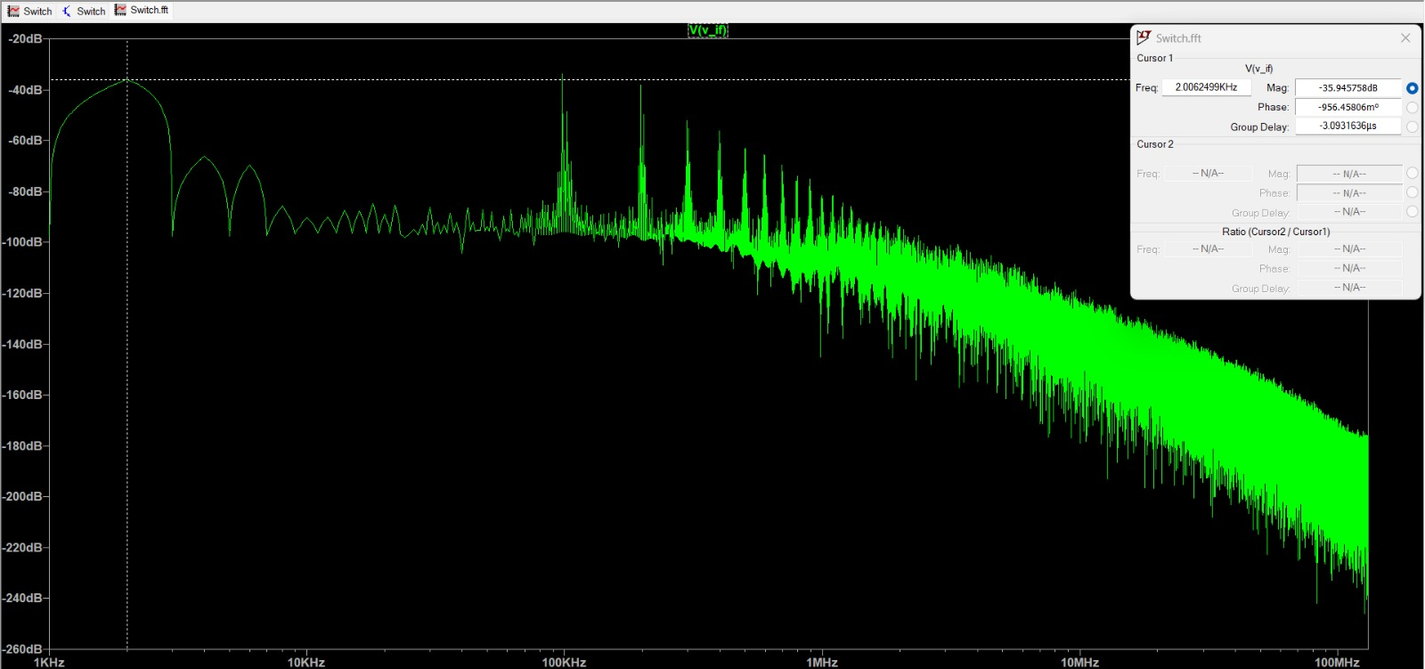
98k
Lab Experiment

Slide 11
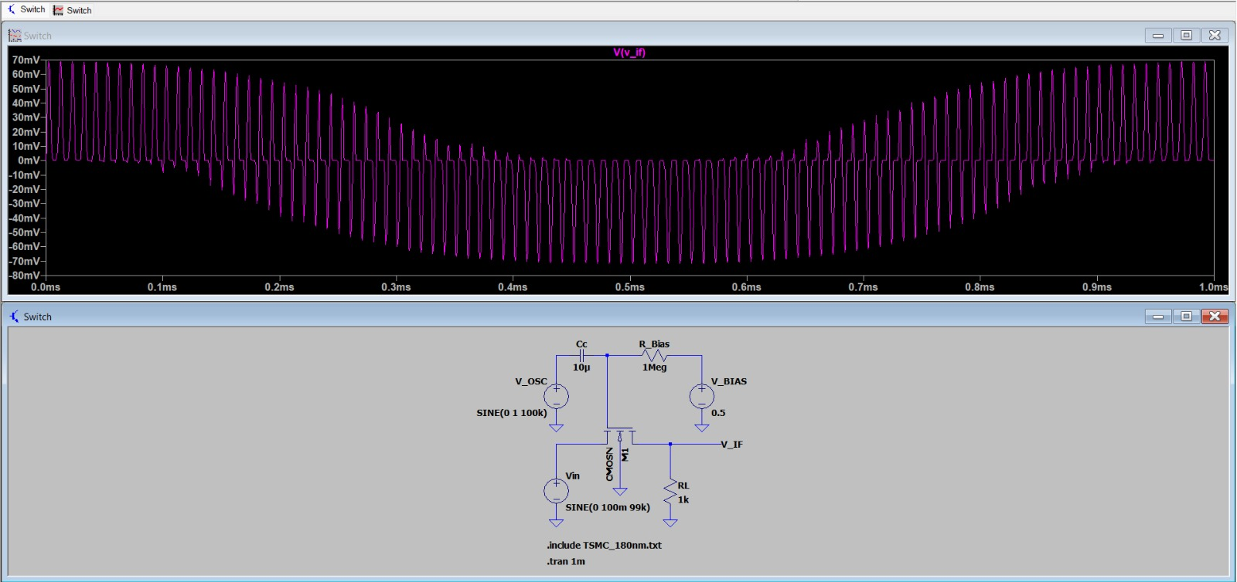
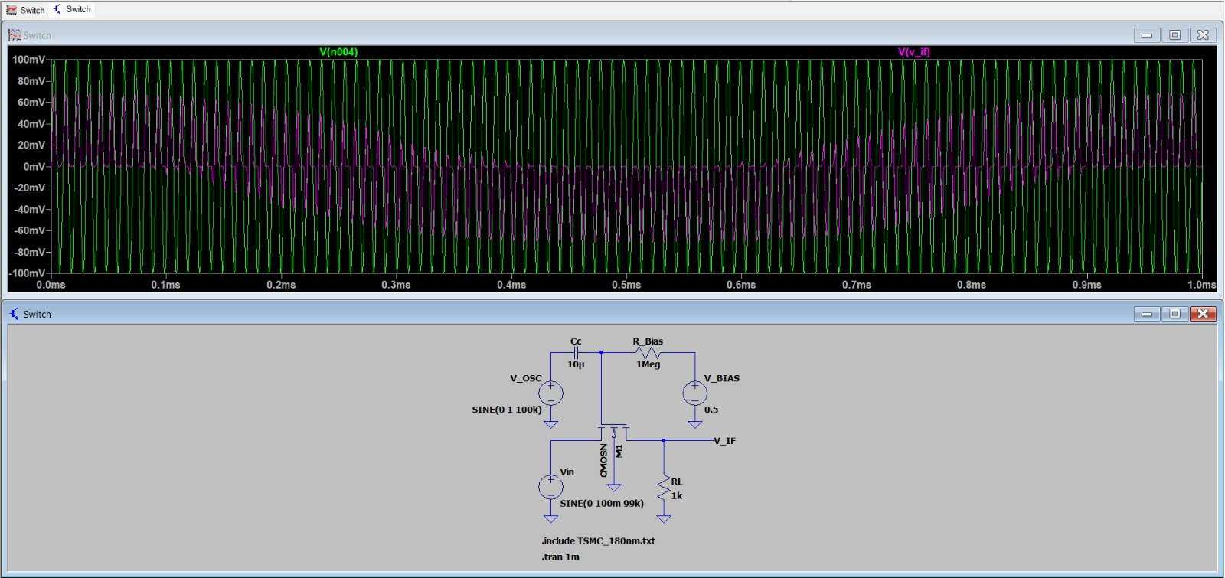
99 k Hz
On LTSpice

Slide 12
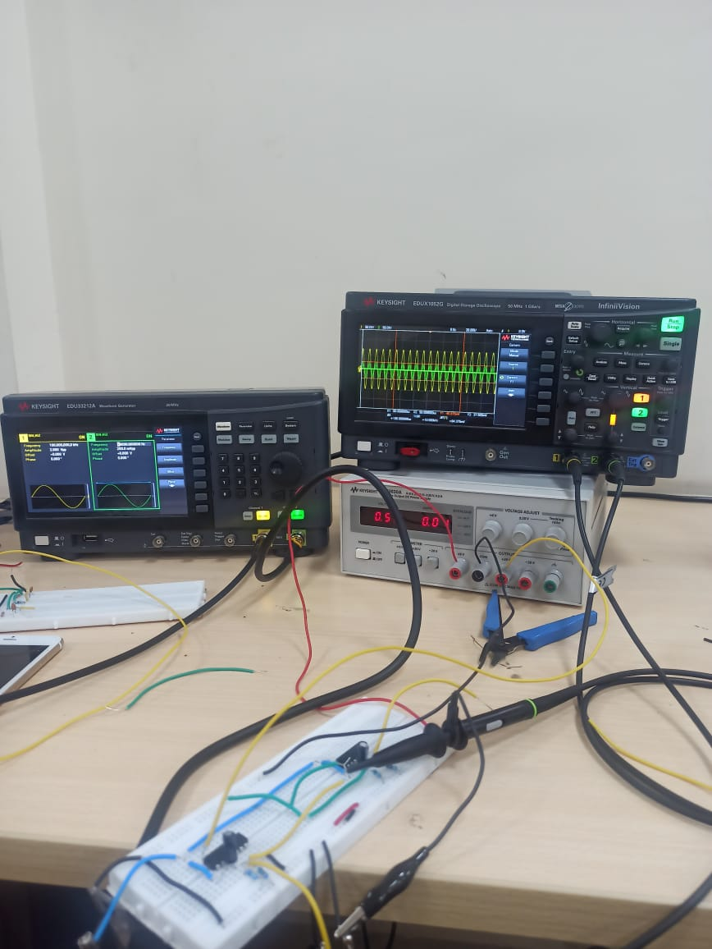
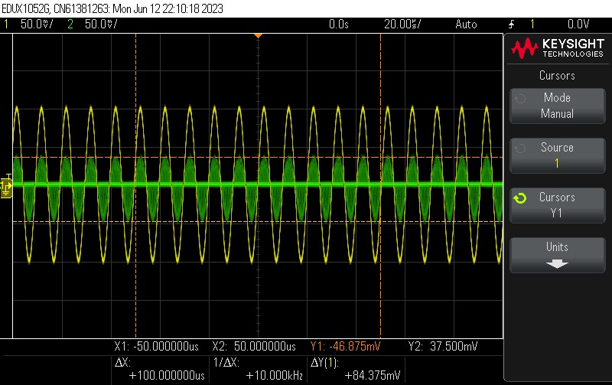
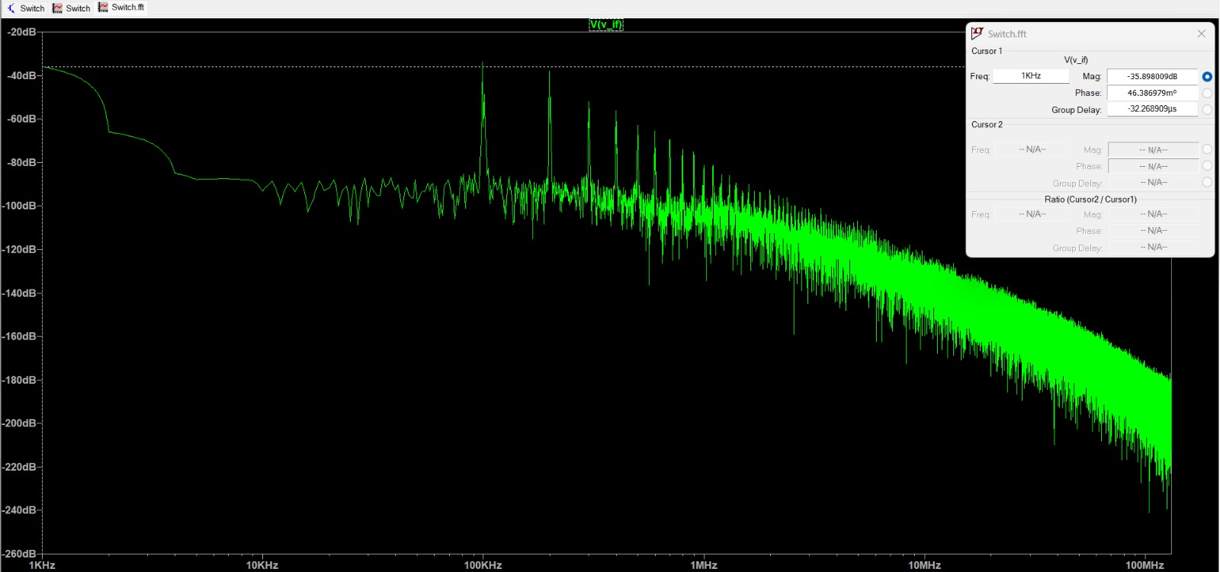
99k
Lab Experiment

Slide 13
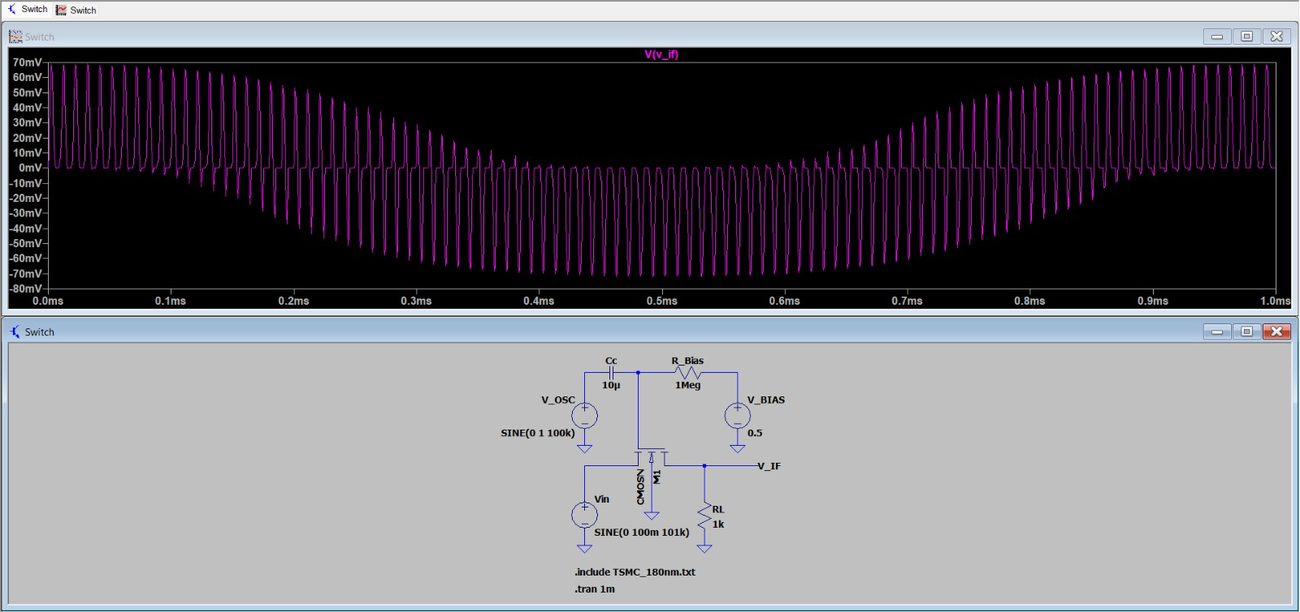
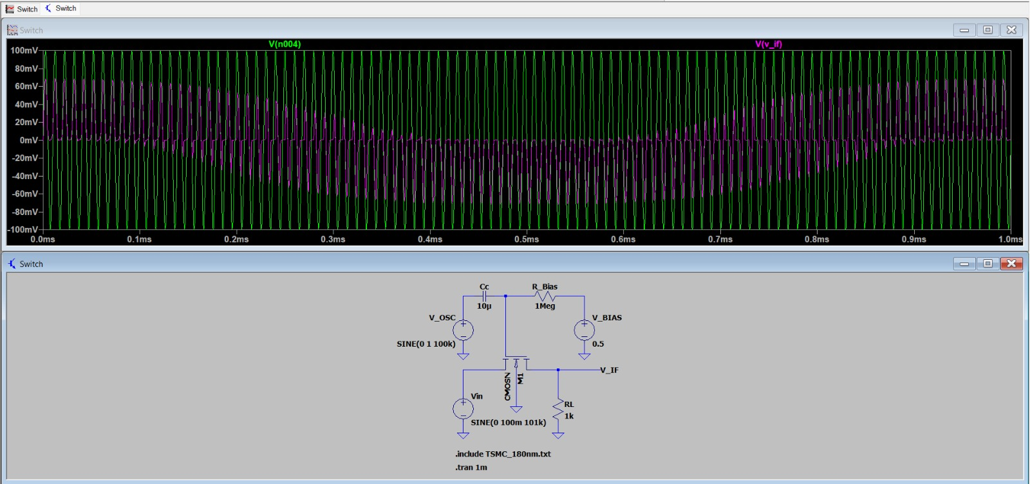
101 kHz
On LTSpice

Slide 14
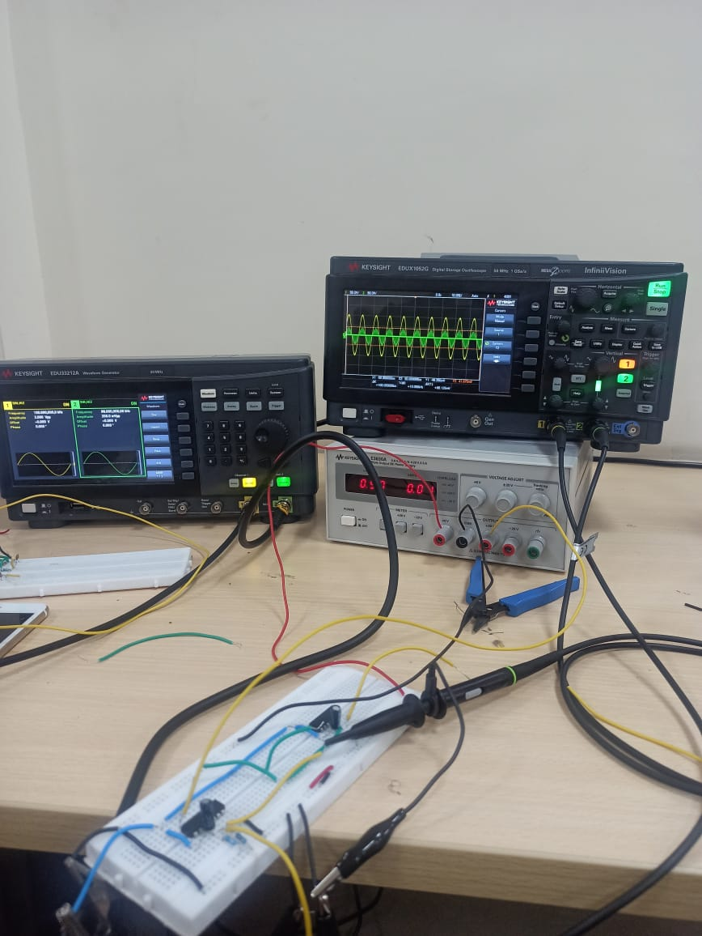

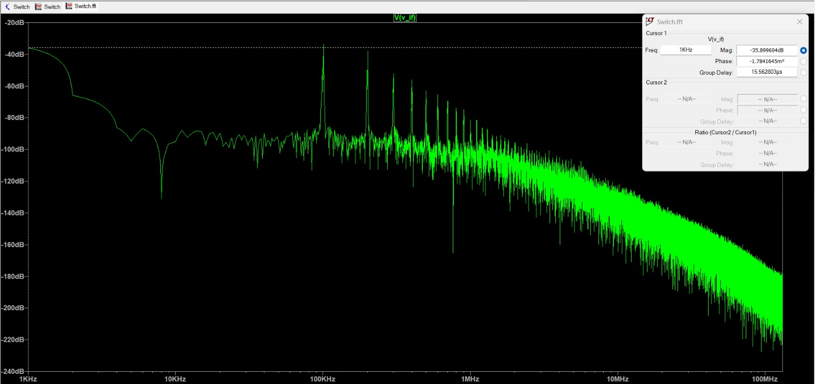
101k
Lab Experiment

Slide 15
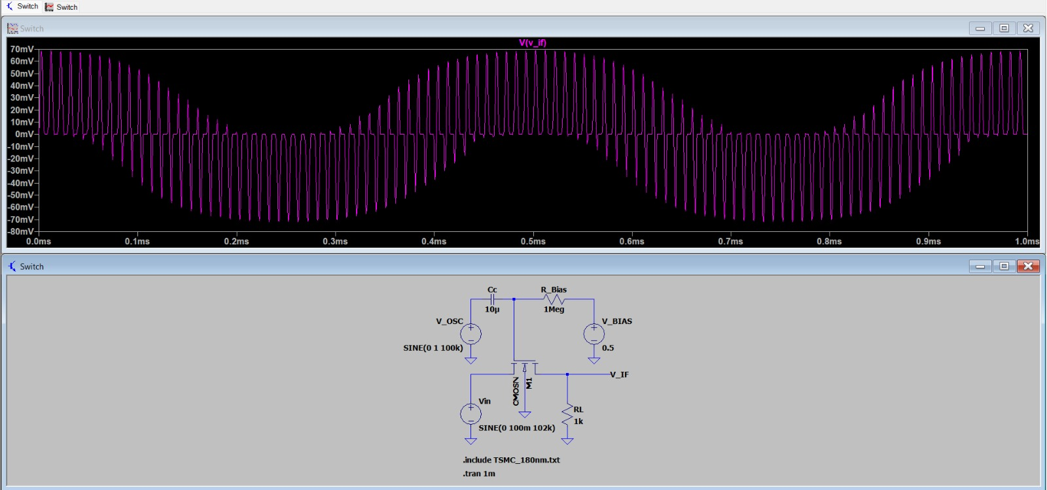
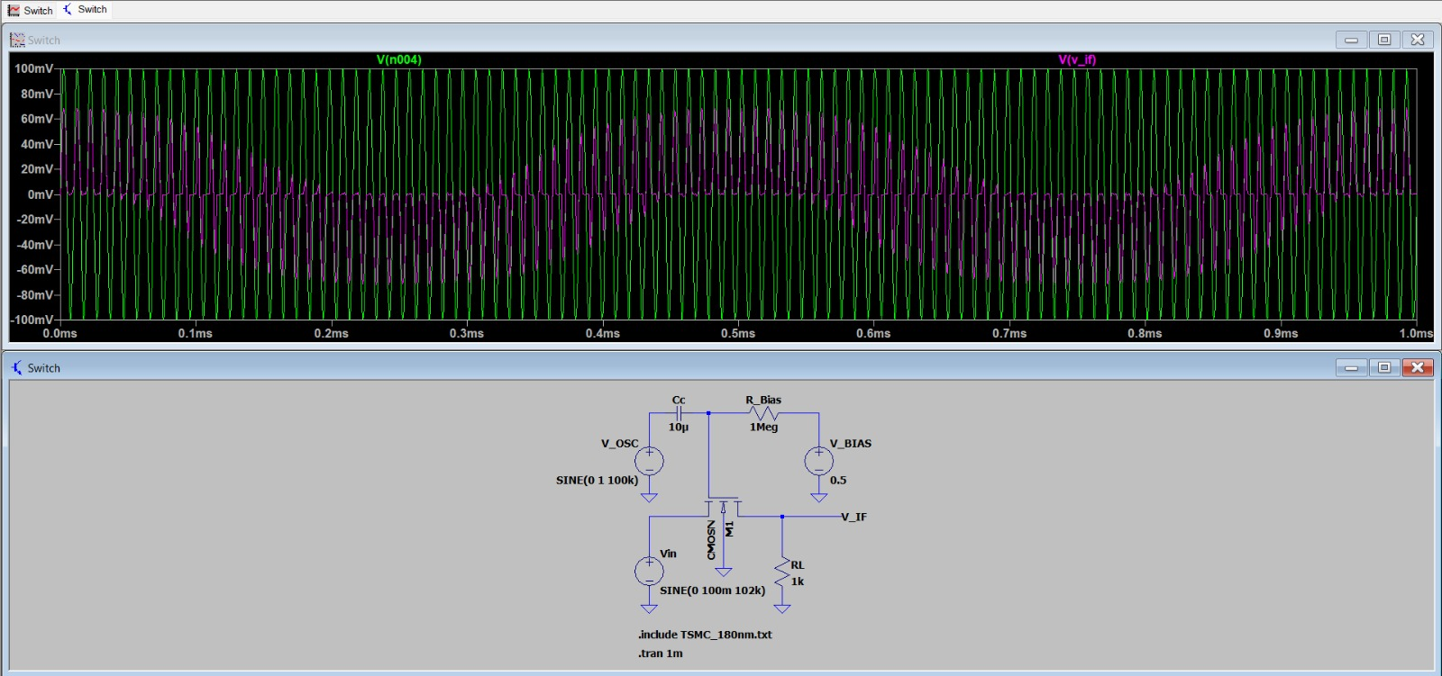
102 kHz
On LTSpice

Slide 16
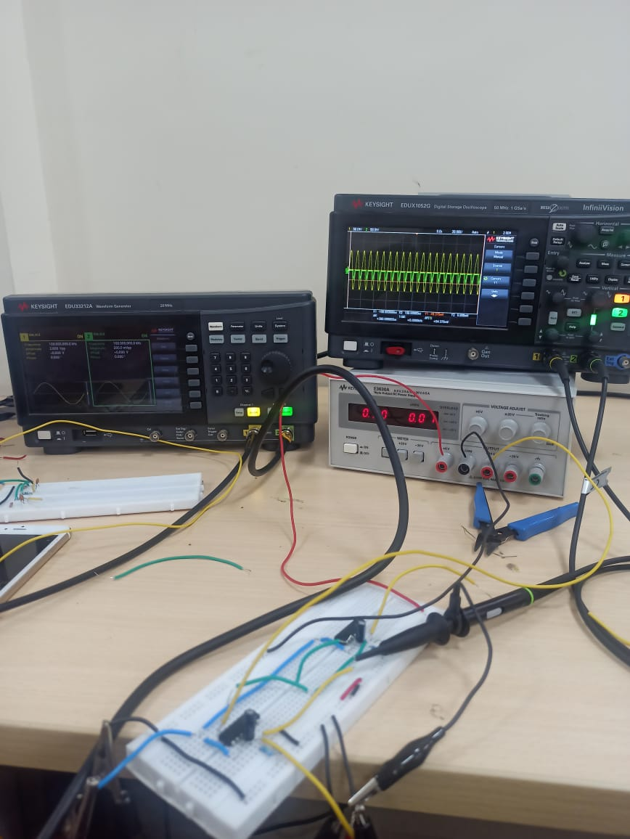
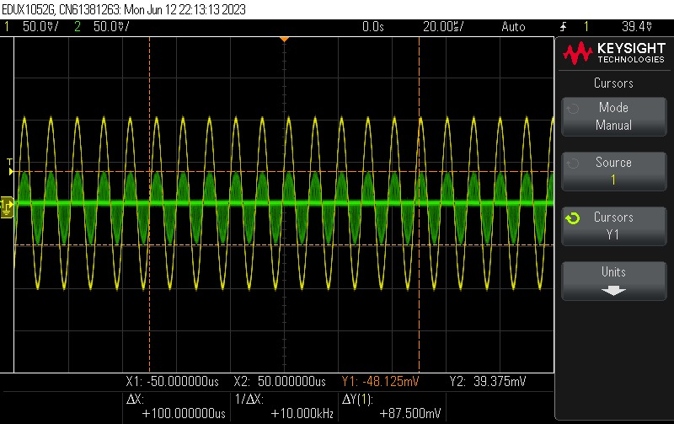

102k
Lab Experiment

Slide 17
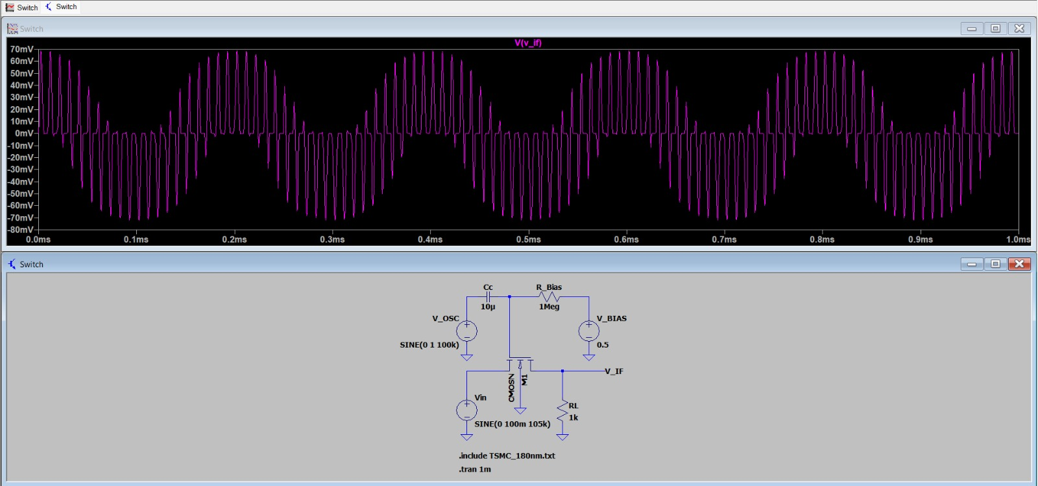
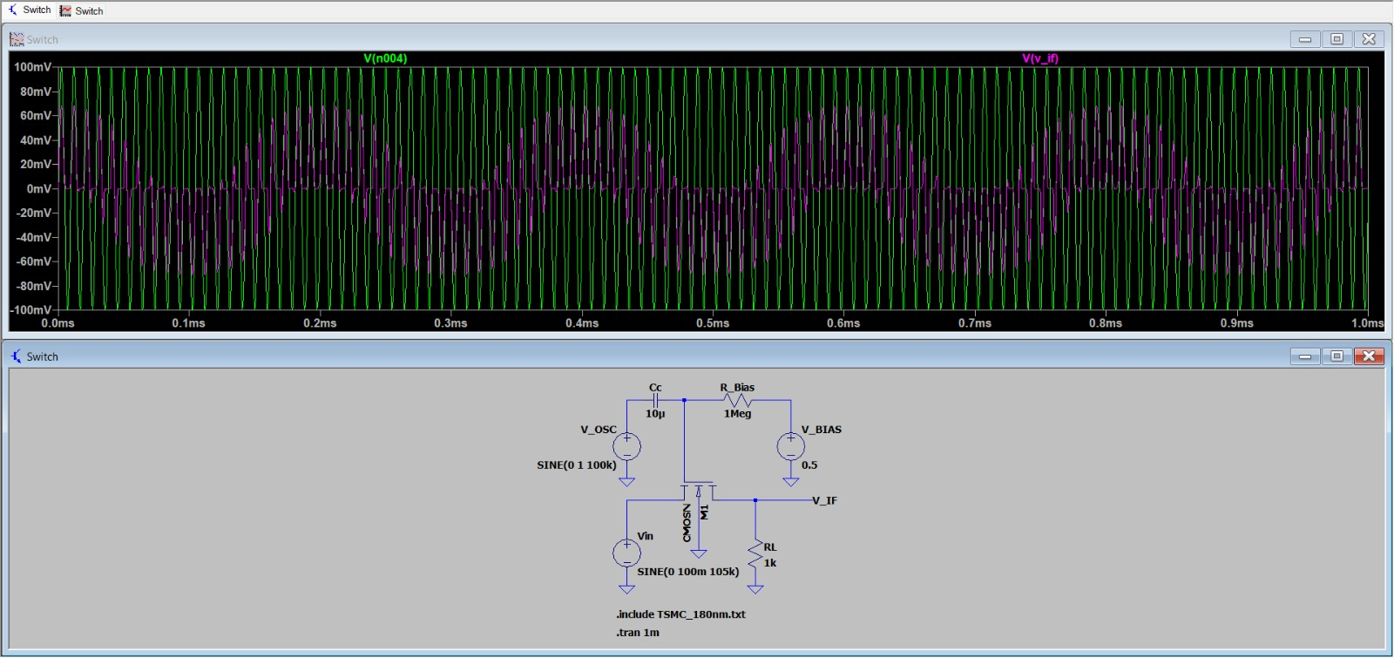
105 kHz
On LTSpice

Slide 18
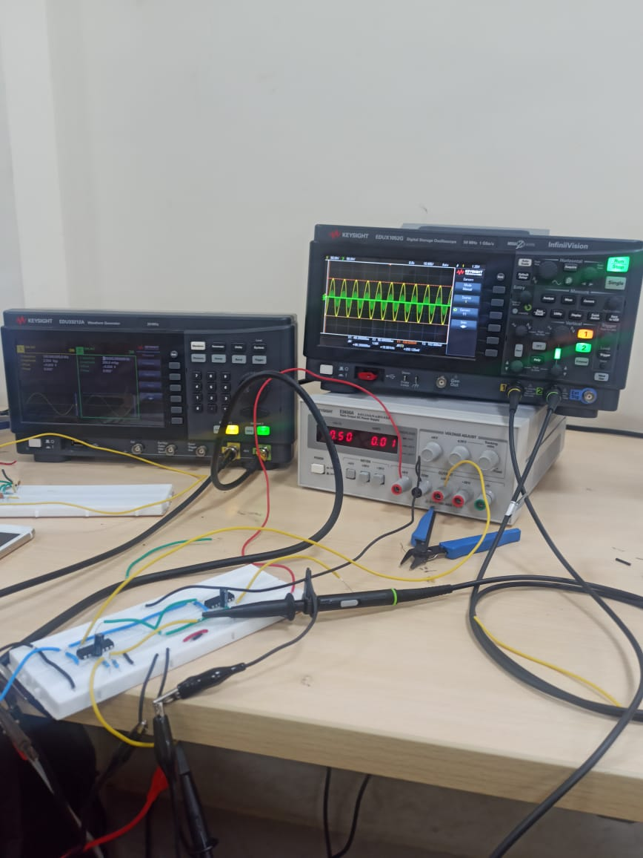
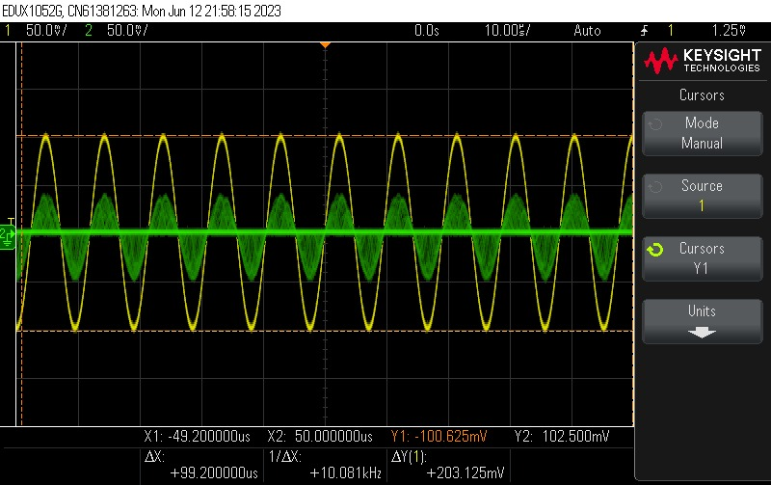
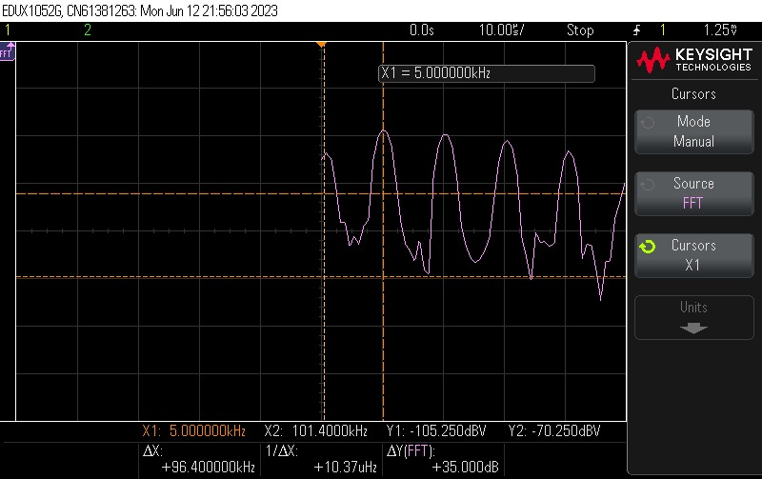
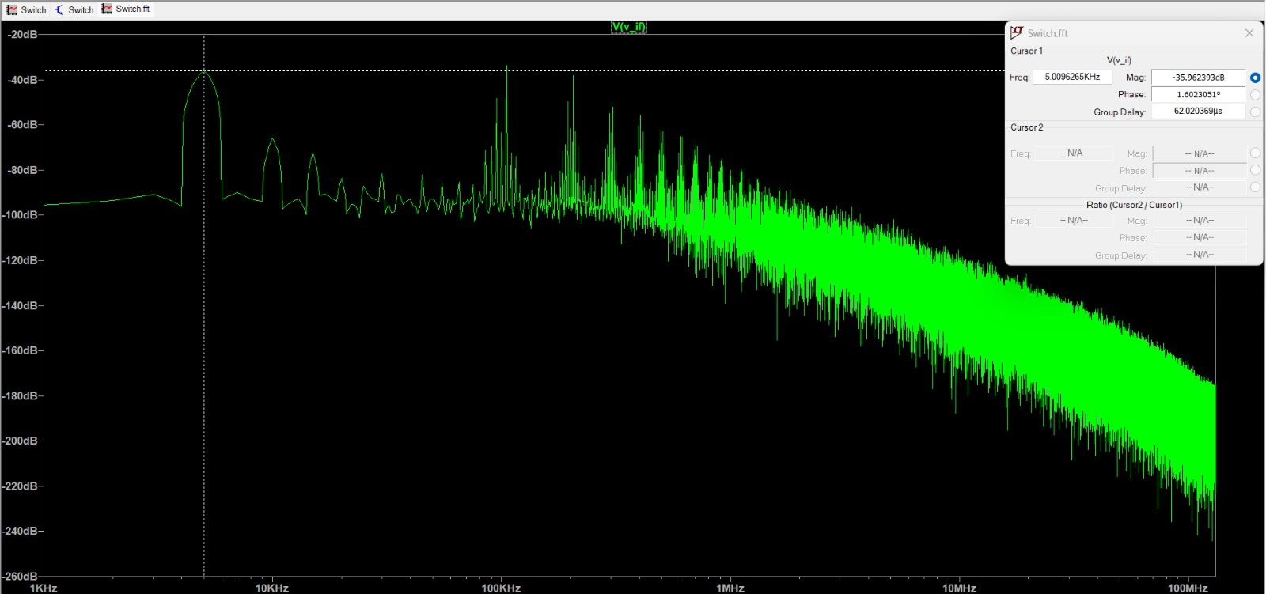
105k
Lab Experiment

Slide 19
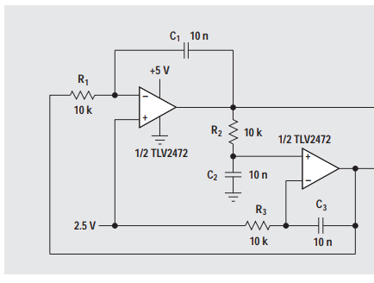
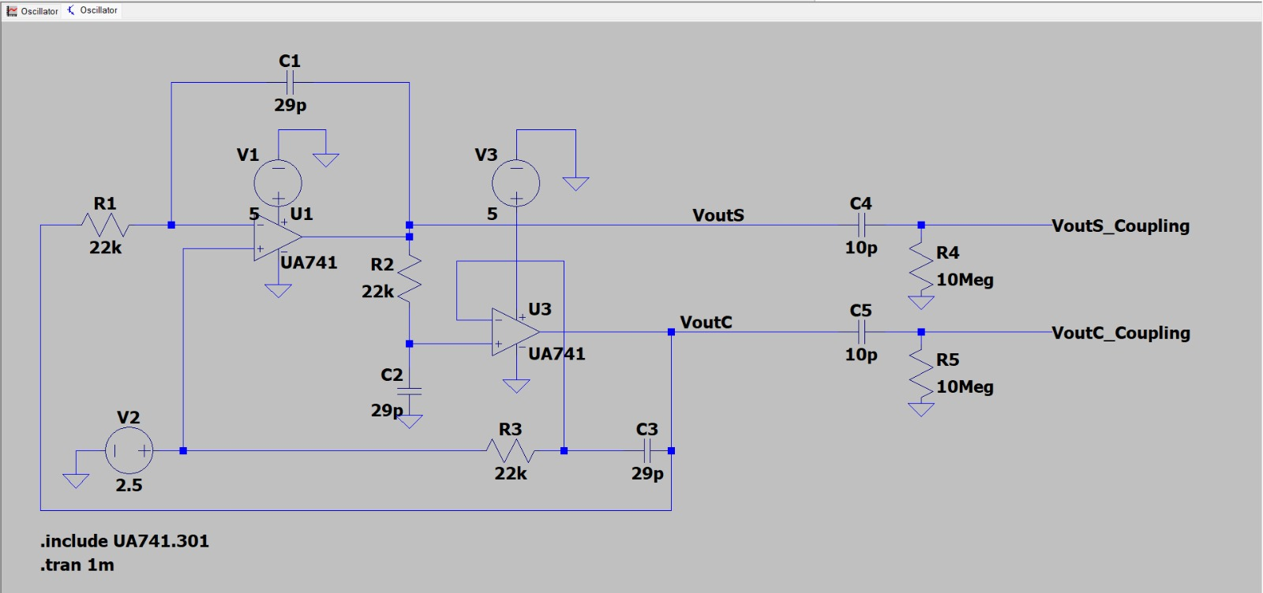
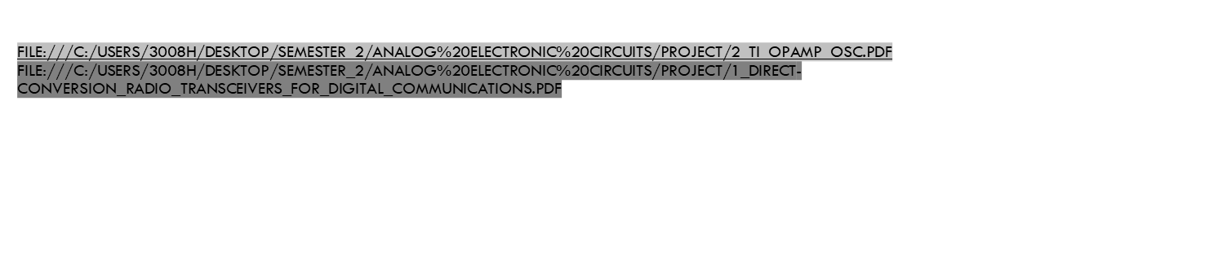
Quadrature oscillator design: using reference from research papers file:///C:/Users/3008h/Desktop/SEMESTER_2/Analog%20electronic%20circuits/Project/2_TI_opamp_osc.pdf file:///C:/Users/3008h/Desktop/SEMESTER_2/Analog%20electronic%20circuits/Project/1_Direct-conversion_radio_transceivers_for_digital_communications.pdf components taken: R1=R2=R3 = 22 kΩ C1=C2=C3 = 29 $μ$F C4=C5 =10$p$F R4=R5= 10MΩ

Slide 20
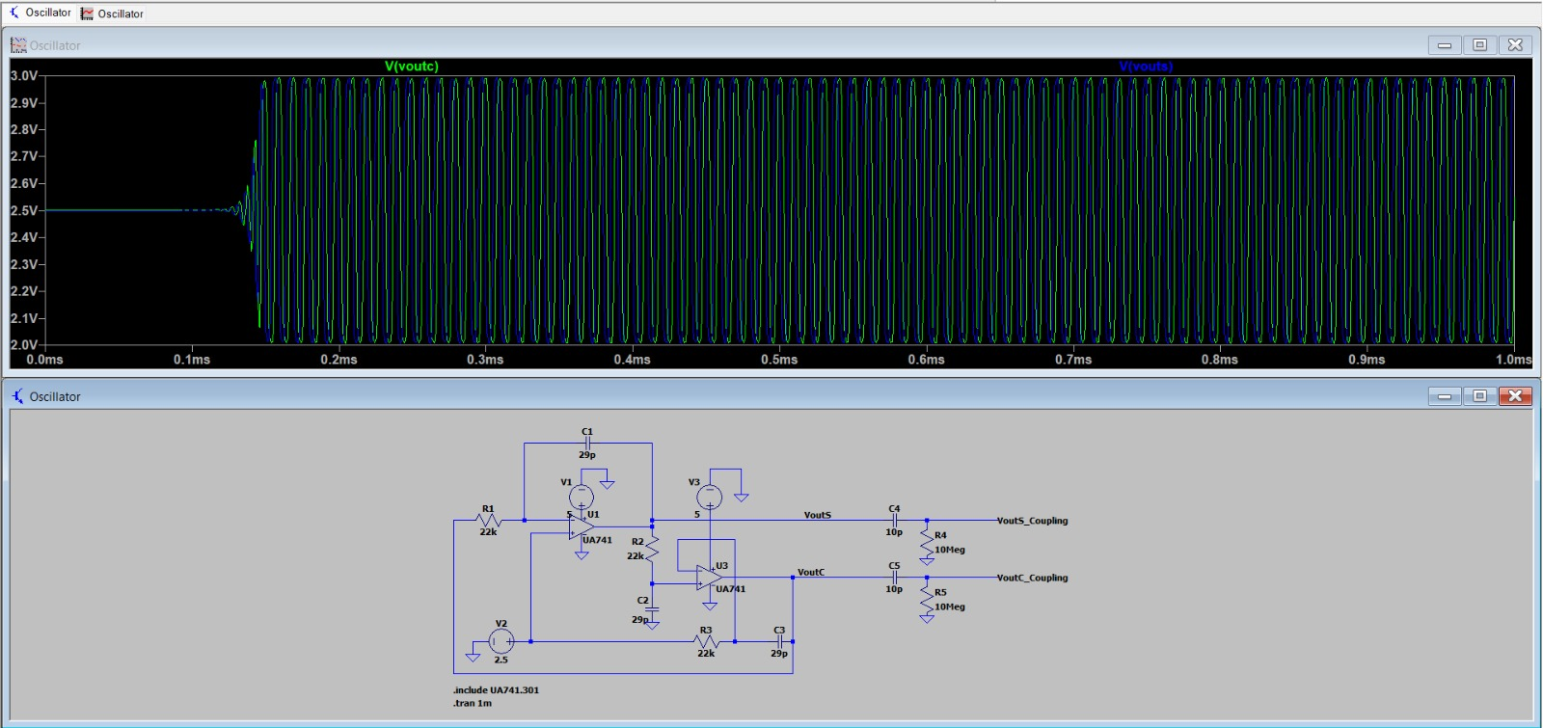
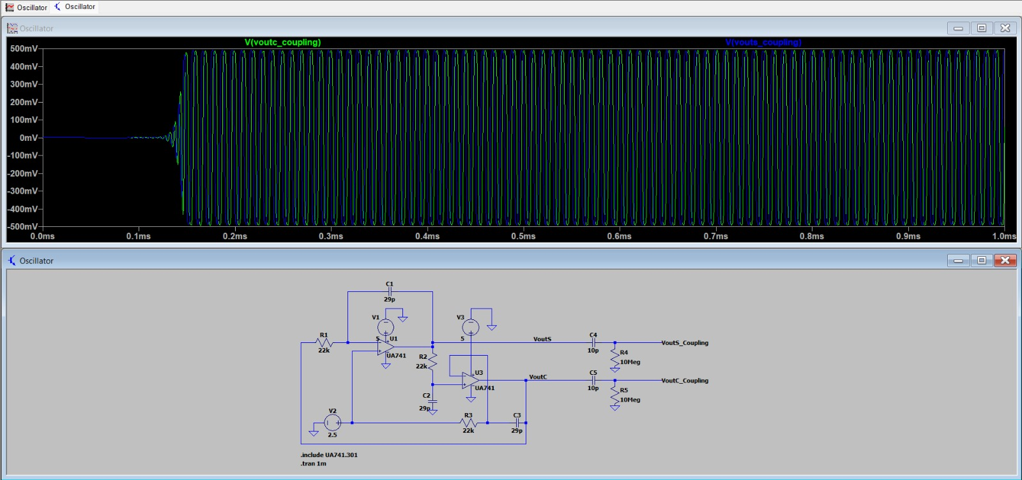
LTSPICE SIMULATIONS

Slide 21
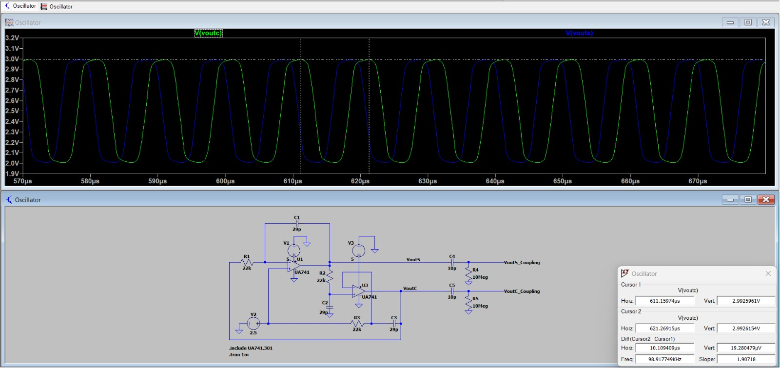


PHASE DIFFERENCE CLACULATION

Slide 22


FFT PLOTS OF COSINE AND SINE WAVE

Slide 23


OBSERVATION OF OSCILLATOR

Slide 24


OSCILLATOR CIRCUIT

Slide 25

COMBINED CIRCUIT

Slide 26


EXPERIMENTAL MODEL

Slide 27



Slide 28




Slide 29



